Slide 1
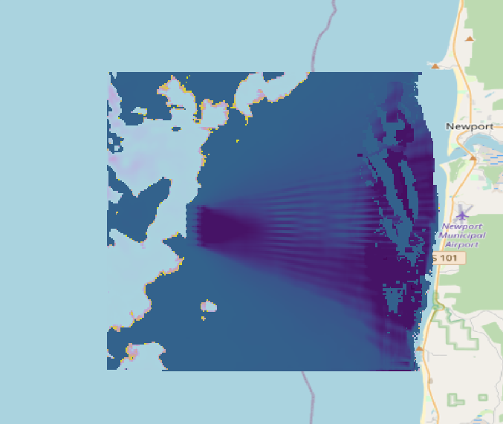
Difference Map Oregon

Slide 2
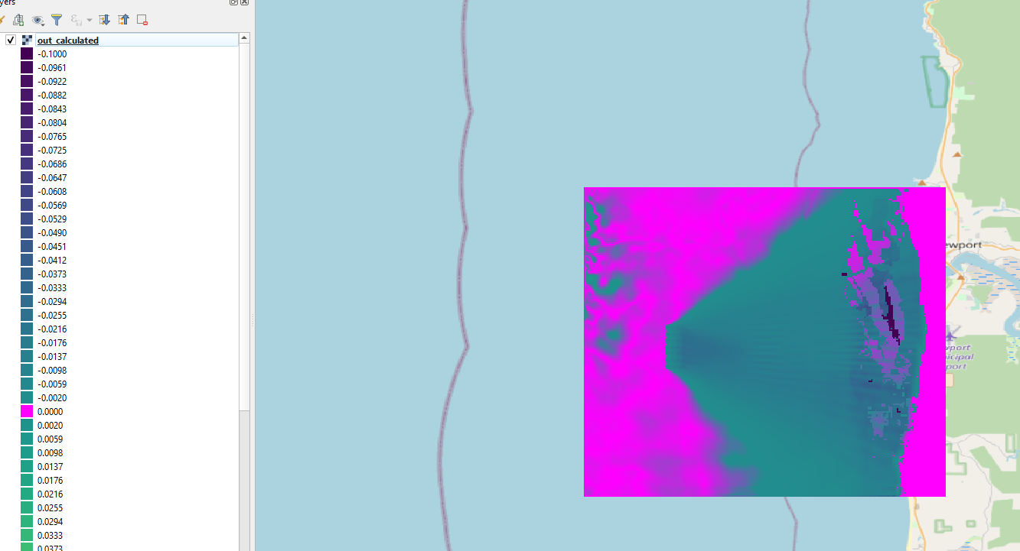
Difference Map Oregon using 4x4 Styles

Slide 3
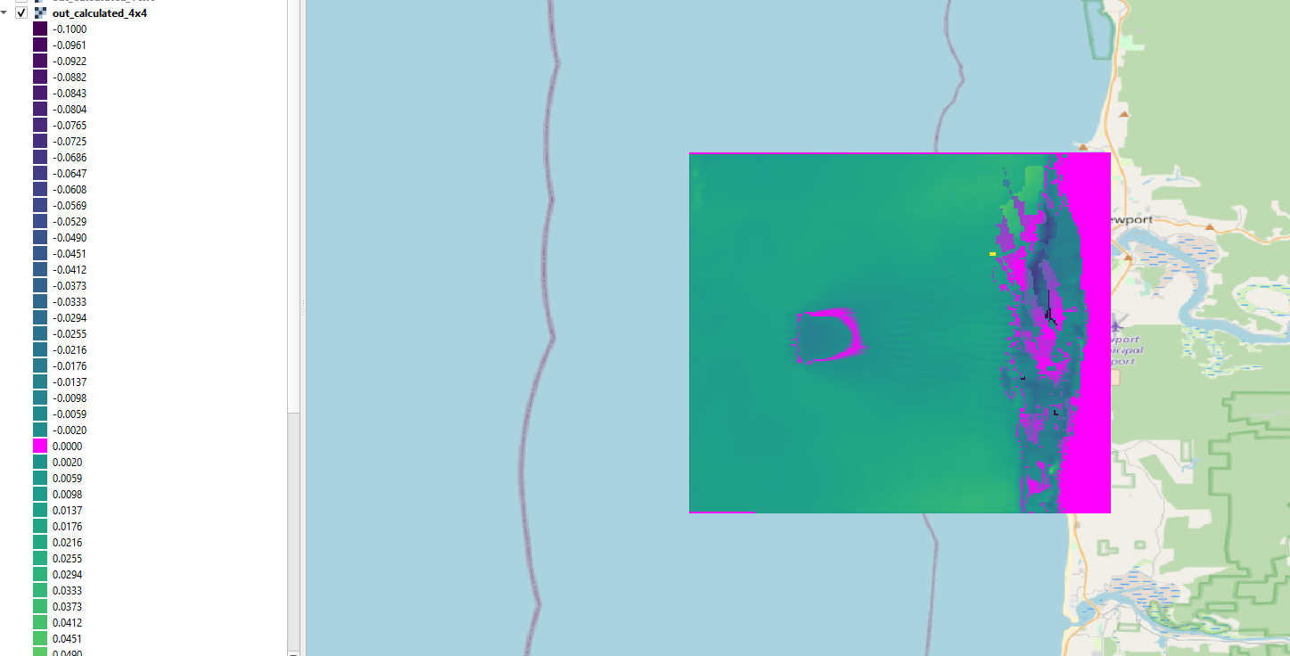
Difference Map Oregon 4x4

Slide 4
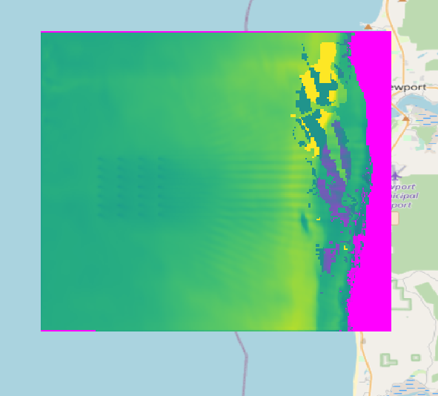
Difference Map Oregon 16x6

Slide 5
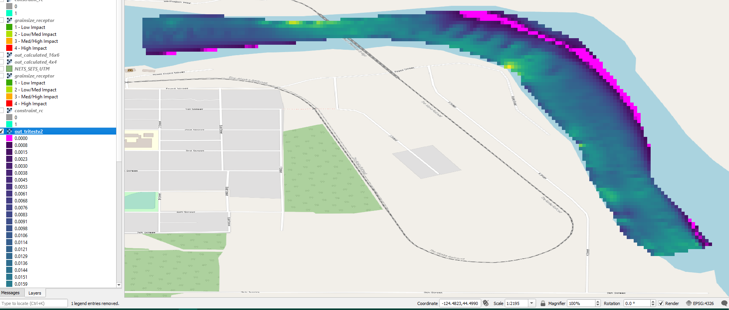
Difference Map Tanana River
This is with device = 9.

